Slide 1
What’s new in Kofax Transformation 7.0
David Wright
Partner Enablement Manager

Slide 2



David Wright
Market Overview
What is Transformation?
What’s New in Kofax Transformation 7.0
Questions
Partner Enablement Manager
Dan Johnson
Director, Product Marketing
Notes:
Talk Track:
With this release of KTA 7.10, Kofax Intelligent Automation Platform expands it’s powerful low-code capabilities for faster and higher business value digital workflow transformation.
Expanding capabilities to further enable Citizen Developers and Business Analysts to accelerate digital workflow transformations.
My name is Omid Aslani and I lead Product Strategy for Kofax’s Intelligent Automation portfolio which includes KTA, RPA, Insight, SignDoc, KCM and several other supporting products and capabilities.
In the next few minutes, I’ll provide you a market overview and walk you through our investment themes for this year.
I’ll then pass it to Dan Johnson, Director of Product Marketing who will be walking you through KTA 7.10 new capabilities and help answer your questions.
As always, please utilize the chat feature to ask your questions and we’ll try to answer as many of them as possible. If your question is not answered, Dan will work with appropriate SME’s to get the responses and share it with you in the coming days.
So let’s get started…

Slide 3

An Increasingly Crowded Market
Document, Content Processing i.e. OCR, ML, NLP
Native Systems i.e., Microsoft
RPA, RDA
Expanding capabilities
Reliance on partnerships
Hyper Automation
iBPMS i.e., analytics, orchestration, workflow, rules
Work Automation i.e., CRMs, ERPs
Kofax integrated platform
Process Mining and Discovery
Low-Code Development
i.e., LCAP, CADP
Notes:
This slide shows how various types of suppliers are all converging toward hyperautomation.
Furthermore, we see many platforms and capabilities converging in order to support this expedited transition towards automaton. And as this convergence and integration to third-party offerings takes place, so does the complication for the buyer and the attainment ROI in a short amount of time as promised by vendors.
Regardless of their starting point, all these companies are adding capabilities that move them toward hyperautomation
Building all these capabilities is difficult, even for large companies, so many rely on partnerships
Kofax is the only provider with our own document processing, RPA and BPM technology, fully integrated into a single platform
Hyperautomation/Intelligent automation is where many companies are moving to. Kofax is already there (next slide).

Slide 4
Where We Currently Play
RPA
Capture
Orchestration
Low-code
Artificial Intelligence
Intelligent Automation ← Kofax focus market
$9.4B Market by 2025 11% CAGR
General Purpose IT Tools
Task/Process Mapping
Rules Engines
Configurable Workflows
Orchestration Across Systems
$36.6B Market by 2025
18.8% CAGR
Process Agnostic Software
$813B Market by 2025
12.3% CAGR
Other Software
Combinations of Various Software Solutions
ERP, CRM, Supply Chain
Source: Gartner
Notes:
This slide shows various categories of software suppliers and the associated market size and CAGR, according to Gartner.
The convergence equals a projected $9.4B revenue in the market Kofax focuses in, that is expected to grow at 11% CAGR.
And what's more is that many of the other players in this space are playing catchup and have point solutions that are expanding via integrations vs. Kofax and our last 3 years of strategic focus to acquire and integrate key native capabilities to drive true E2E DWT.
Kofax focuses on the IA market. Unlike other companies who are migrating in this direction, this has been our focus for several years
Customers trust us because we have extensive, proven expertise in the core IA technologies. Some of the companies in the “other software” category are bigger, but AI is an add-on to their primary business
Low code enables workflow creation and enablement of Citizen Developers – Enabling the innovators

Slide 5
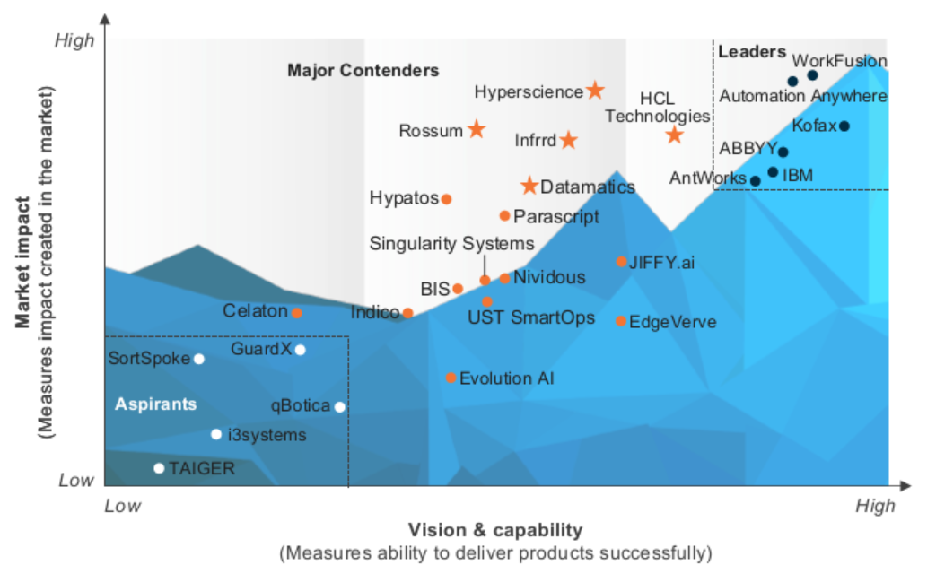

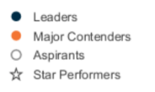
Intelligent Document Processing (IDP) Everest Group PEAK Matrix – April 2021
Confirms Kofax’s position as a leader in IDP
Leaders continue to enhance AI capabilities, and add complimentary technologies such as RPA, process mining, eSignature, integration, and workflow.
Consistent with the capabilities of the Kofax Intelligent Automation Platform
Highest score for vision and capability
Rated higher than ABBYY and IBM
Notes:
This slide shows a more focused view than the previous slide.
The Everest PEAK study is focused on IDP, which is at the core of document-intensive workflows
In this more focused report (compared to Forrester), Kofax is clearly a leader
Note that leaders also have complimentary technologies such as RPA, process mining, e-signature and workflows. Kofax offers all of these in our IA platform
Takeaway: In a study that aligns closely with document-intensive workflows, Kofax is a clear leader.

Slide 6
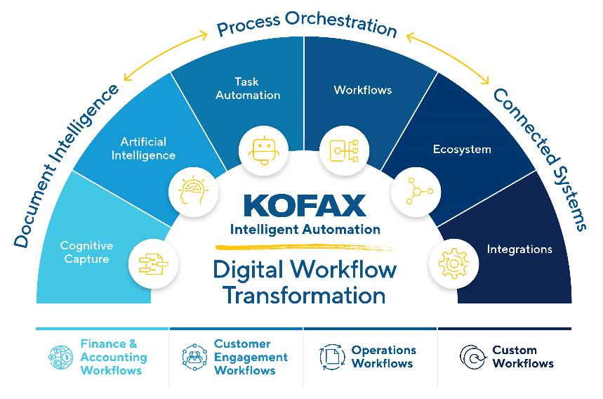
Product Focus Areas
TotalAgility is the core of the Kofax Intelligent Automation platform
AI-driven document intelligence
Low-code simplicity
Orchestration of human and digital workforces
Connectivity to critical business systems
Kofax is the only vendor providing its BPM, RPA and Document Intelligence in a single integrated platform

Slide 7




TotalAgility Key Investment Areas
Advanced support for security, compliance, scale, audit, and cloud
Developer Tools
Simplified development of robots and maintenance, tools and debugging
Kofax Robotic Process Orchestration (RPA)
AI & Cognitive Capture
User Experience
Digital Workflows
Integrated Cloud
Platform
Expanded cognitive capture and AI capabilities to extract unstructured data from documents
Improved user experience and capabilities to simplify the development of digital workflows
Enhanced digital workflow creation, tracking and visualization for powerful automation
Enhanced functionality around Cloud, Marketplace, and integration to TotalAgility
Notes:
AI and Cognitive Capture: Expand AI beyond capture (fraud detection, trend analysis, intent detection, open predictive/adaptive engine)
User Experience: Empower the citizen developer through continued investment in low-code and intuitiveness of UI/UX
Digital workflow: To deploy the transformation initiatives at scale, enterprises need to overcome siloed operations and better manage the interplay between various systems – resulting in increased demand for process orchestration solutions. Due to COVID, enterprises are looking for faster deployments, which has led process orchestration providers to accelerate the deployment of prebuilt function, vertical, and technology-specific packaged solutions.
Integrated Cloud Platform: Cloud-based deployments are gaining traction due to their scalable architecture, easier accessibility, reduced overhead investment and lower cost and effort of infrastructure management. Lead with modern, cloud-centric architecture and support structure
Our secret sauce = Capture + RPA + SignDoc + BPM + AI all from one company to truly drive end to end digital transformation

Slide 8


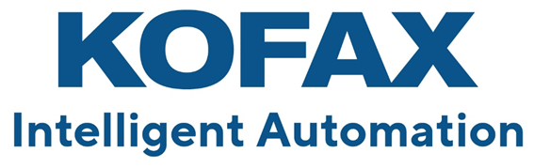
Kofax Transformation is the heart of Kofax
Kofax Transformation
is the
Intelligent AI and Cognitive Capture
in
Notes:
Kofax helps businesses and companies communicate with each other via any method.
Kofax Transformation is what understands the message.
Kofax’ other solutions capture, KTA, Printix, MFD, Mobile, RPA are all infrastructure to transfer messages, but they don’t understand the message.
Understanding the message is Kofax’ real value.
To turn your 6 figure deal to a 7 figure deal, make it one that understands the message.

Slide 9





What is Document Understanding? (All information has context)
General Knowledge
Specific Knowledge
Learning
Understanding
=
Reading
+
+
+
Precisely knowing the intent of the author
OCR
Letters & words
This is not understanding
People’s names, City names, Tax rates, Mathematics, Month names, Job names…
Date of birth of each customer, order database signature always on the last page.
Remember and use new general & specific knowledge next time.
Notes:
Reading= OCR = intelligence of a 4 year old child.
General knowledge (about documents and the world)= city names, zips codes, mathematics, languages, spelling, month names, common occupations.
The words “date” and “Datum” often appear to the left of a date.
One Third of Americans share only 1000 family names – Smith, Johnson, Williams, Brown, Jones, Miller, Davis, Garcia, Rodriguez.
Robots are good at getting general knowledge about the world.
Specific knowledge (about this document) = the address and date of birth of every customer. Database of recent orders. This document always has the date in top left corner.
Learning by observing= gaining general and specific knowledge.

Slide 10
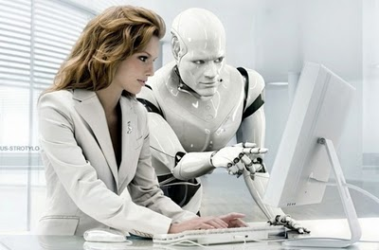

Notes:
Great KT solutions build wonderful collaboration between humans and robots. Robots always support humans, never replace them. This picture describes in great detail what we are doing with Kofax Transformation – always putting the human in the center and in control, with human hands on the keyboard. The human never gives control to the robot and the human remains always responsible. We do not let AI make decisions about human lives – only humans can do that.

Slide 11
What’s new in Kofax Transformation 7.0
New OCR engines
Kofax Total Agility
Kofax Capture
Kofax Transformation Toolkit
Kofax Mobile Capture
Kofax RPA 11.3 (April 2022 does not have KT 7.0)

Slide 12

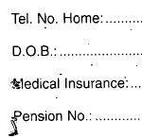

OCR vs ICR
Optical Character Recognition
Machine print
Intelligent Character Recognition
constrained
unconstrained cursive (intelligent word recognition)

Slide 13

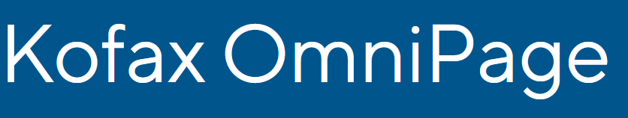
Kofax Omnipage 21.1 is an OCR Document engine.
Convert any document. “Converting scanned image to Word document” produces faithful transcriptions of most forms of handwriting and virtually any computer font
Paragraphs, layout, columns, images, tables
130 languages, including Japanese, Chinese (x2), Korean, Thai, Vietnamese, Russian, Turkish, Greek, Arabic, Hebrew, Serbian (both Cyrillic and Latin)

Slide 14

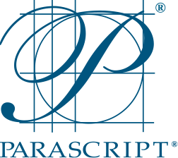







Parascript FormXtra 7.6 is a cursive and check OCR engine
Machine print (OCR)
all forms of handwriting (ICR)
constrained
unconstrained handprint
cursive handwriting (IWR)
English, German, French, Spanish, Brazilian Portuguese,
Russia

Slide 15



Kofax’ Recommendations for OCR and ICR
✔=possible, ✔ = recommended, - = not possible
Full Page Document
 | Machine (OCR) | Hand (ICR) | Cursive (IWR)
Kofax Omnipage | ✔ | ✔ | -
Parascript FormXtra | - | - | -
Kofax Clarity (Google Vision) | ✔ | ✔ | ✔
Forms/Zones/Checks
 | Machine (OCR) | Hand (ICR) | Cursive (IWR)
Omnipage | ✔ | ✔ | -
Parascript FormXtra | ✔ | ✔ | ✔
Kofax Clarity (Google Vision) | - | - | -
Notes:
Kofax Onipage uses Kadmos for Handwriting.

Slide 16
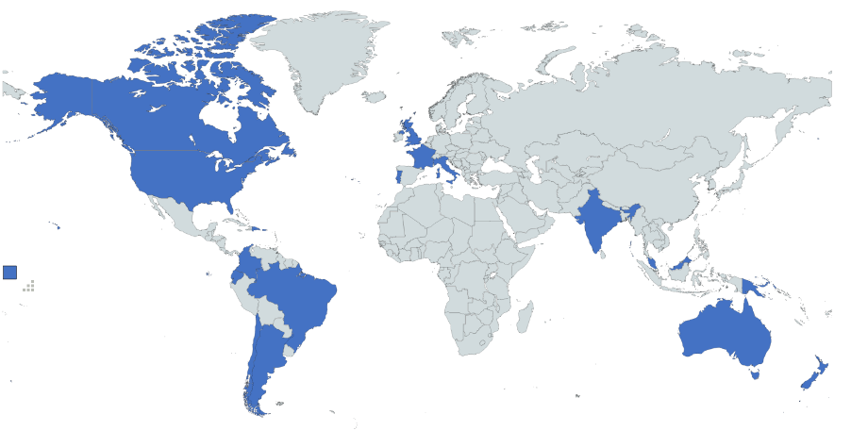
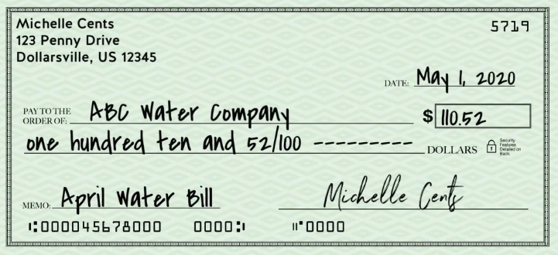
Parascript Check Locator
Date
Amount
Check Number
Amount (CAR), Text Amount (LAR)
Payee
MICR Account Number
MICR Amount
MICR Check Number
MICR Aux on US
MICR IRD
Notes:
Argentina, Australia, Brazil, Canada, Chile, Colombia, Dominican Republic, Ecuador, France, India, Italy, Malaysia, New Zealand, Papua New Guinea, Portugal, United Kingdom, United States
CAR = courtesy amount recognition(numeric)
LAR = legacy amount recognition(text)
MICR Aux on US is a special character in the MICR for US Business checks.
IRD = Image Replacement Document

Slide 17
Parascript Check Licenses
Name in License Utility | Id | Parascript Engine
Kofax Transformation Check Processing Worldwide (Plus) | 219 | CheckPlus International or CheckPlus USA
Kofax Transformation Check Processing US High Accuracy (Ultra) | 220 | CheckUltra
Kofax Transformation Check Usability (Brazil, USA, India) | 221 | CheckUsability
Legacy A2iA licenses will be transferred to plus + ultra + usability.
Contact Kofax Sales.
36=13*3 field usability results:
presence/readability/handprint
97 image usability results:
Partial image, skew angle, torn edges, contrast, brightness, out of focus, spot count, endorsement, streaks, corner detection, undersize, oversize, dimension, mismatch…

Slide 18
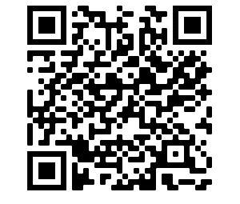
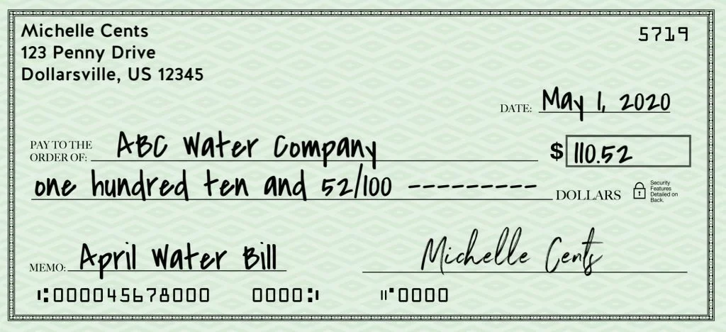
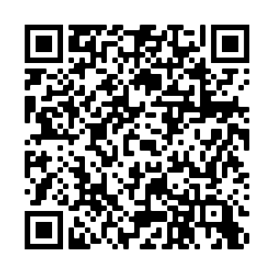
More information about Checks
A video has been created to guide customers through modifications
A Knowledge Base article is also available

Slide 19
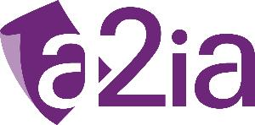

Migration of Profiles in Project Builder/Design Studio
Cursive Zone Profiles
Page/Zone Profiles

Slide 20
Barcode Locator
The Barcode Locator now uses OmniPage 21.1.0.6 and no longer FineReader
3 barcode types no longer directly supported
Code 32 (on the roadmap for OmniPage)
MaxiCode and Aztec (Supported by the EBC engine available in KC)
Benchmark comparison with Kofax Atalasoft (best known engine before testing OmniPage)
Tested 745 barcodes of these types: Codabar, Code 128, Code 39, Code 39 Extended, Code 93, Ean13, Ean8, Interleaved 2 of 5, UCC/EAN Code 128, UPC-A, 2D, QR, Data Matrix, Pdf417
Atalasoft 78%, OmniPage 89%

Slide 21
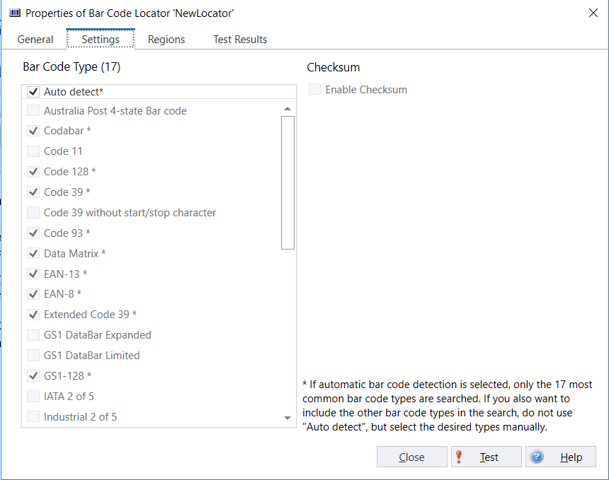
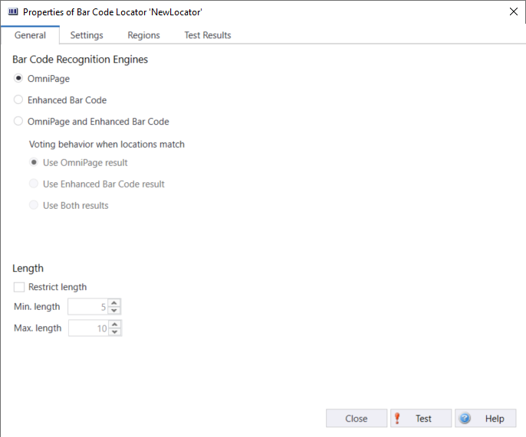
Barcode Locator

Slide 22

Barcode Locator
Some notes
Some bar code types are mutually exclusive, like „Code 39“ and „Code 39 with start/stop characters“
There is a high accuracy variant of PDF 417 detection. High Accuracy is slower
Auto Detect includes only the 17 most common types for performance reasons
If you need to figure out the unknown type of a barcode in designer, you can select all 32 barcode types for testing, but that is slow and thre is no need to do that in production.

Slide 23
Trainable Group Locator
multiple TGLs in the same class now share the training set rather than each of them loading it into memory. This allows handling larger projects with more samples and more TGLs per class

Slide 24

The OCR problem

Slide 25


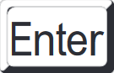
How our customers see OCR
✓
We need
85% accuracy!
≥ threshold valid
Confidence threshold
< threshold invalid

Slide 26






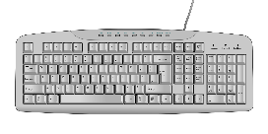



Some real examples
Accuracy
☠
✓
correct and valid
incorrect and valid
Correct and valid
correct and invalid
incorrect and invalid

Slide 27



A real example
447 handwritten names using Parascript FormXtra 7.6 OCR profile “Hand Alphabetic”
✓
☠
Confidence threshold | correct & valid | correct & invalid | incorrect & invalid | incorrect & valid
80% | 18.3% | 72.5% | 8.9% | 0.2%
 | Accuracy = 90.8%
 |  | Human effort = 81.4%
 | - | 1 second | 1.5 seconds | -
 |  | =0.86 seconds
 |  | Productivity gain = 1.74
= 1 x .725 + 1.5 x 0.089
= 1.5 / 0.86
Notes:
Human+Kofax = 0.86
Human alone = 1.5
Kofax produces a 1.5 times boost/productivity gain

Slide 28



Optimization Process
☠
:
$€¥£
✓
OCR Configuration | Optimum Confidence | Correct &Valid | Correct &Invalid | Incorrect &Invalid | Incorrect &Valid | Accuracy | Human required | Correction ratio | Productivity gain
Alphanumeric | 82% | 0.2% | 83% | 16.8% | 0.0% | 83.2% | 99.8% | 17% | 1.4
Alphabetic | 80% | 18.3% | 72.5% | 8.9% | 0.2% | 90.8% | 81.4% | 11% | 1.7
FirstName | 79% | 15.2% | 72.3% | 12.5% | 0.0% | 87.5% | 84.8% | 15% | 1.6
Alpha + 2300 Names | 67% | 51.9% | 37.4% | 10.7% | 0.0% | 89.3% | 48.1% | 22% | 2.8
= 89.3%
=
Kofax focuses on humans and human problems, not on software and robot metrics – we find the optimal solution that reduces human effort and saves money.

Slide 29

Change the conversation with your customers
$€¥£
Accuracy and Confidence
Productivity Gain
Notes:
http://1.bp.blogspot.com/_6SchU8D-e1s/TQjtsuh0-tI/AAAAAAAAn4Y/0FHaAX_WEh4/s400/human-vs-robot-13.jpg

Slide 30
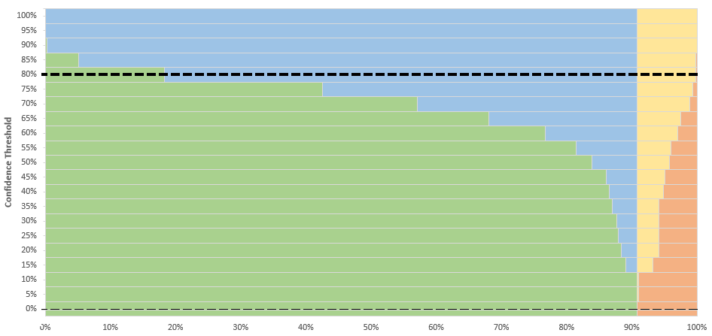

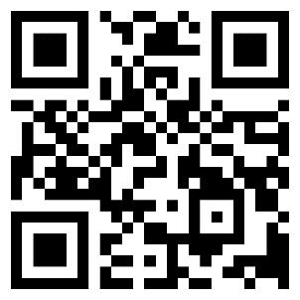
Community of Practice - 7 June 2022 Confidence Threshold Optimization Tool
✓
☠
https://cvent.me/Y7gqWA

Slide 31
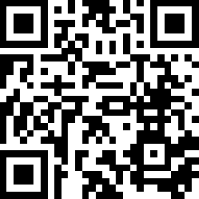
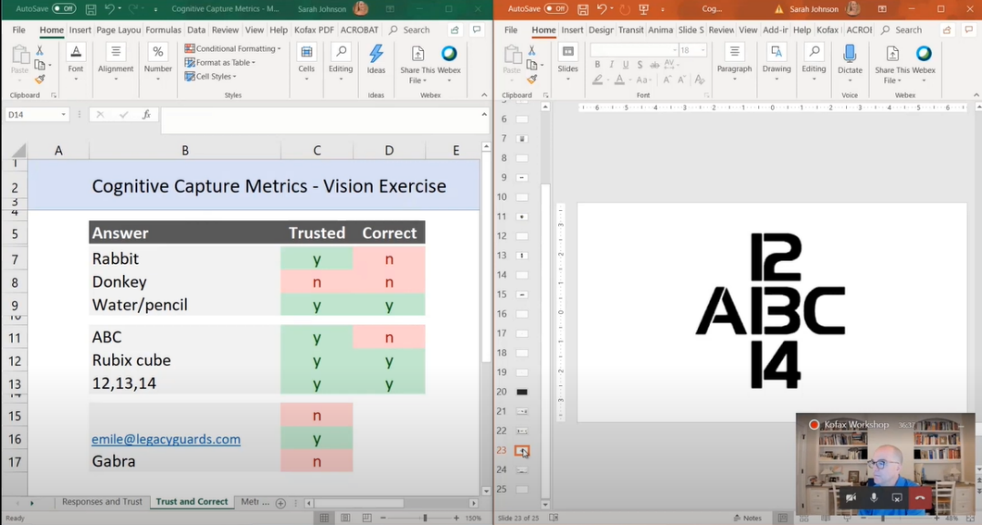
Another approach to the accuracy problem
https://youtu.be/tW-XVA0Mr1Q?t=813

Slide 32
Observations for Parascript FormXtra on handwritten Names
Alphabetic Profile is better than Alphanumeric
LastName is better than FirstName.
Name profiles are much slower than Alphabetic.
Use dictionaries with alphabetic profile. Name+dictionary is not more accurate.
Dictionaries double productivity, but not accuracy.
Dictionary size doesn’t really matter if the dictionary contains “Top X” values.

Slide 33
Q&A

Slide 34

Thankyou!
Check cvent for upcoming webinars, Communities of Practice, video playback, and downloads.
https://cvent.me/Y7gqWA

